Slide 1
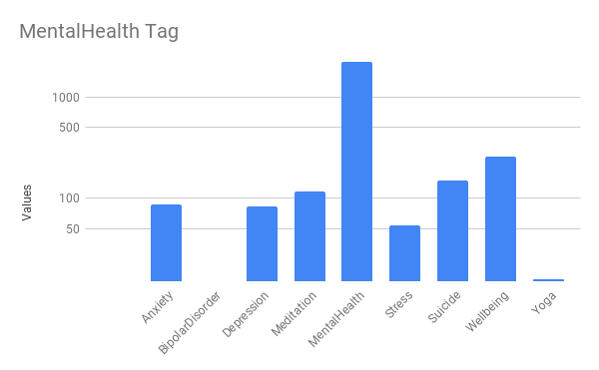

Mental Health Analysis Through Twitter
MSc Information Technology, Social Media and Web Science, Student No:21012116
Introduction
Findings
Discussion
The different social sites enable the individuals to communicate with each other. A lot of different social media messaging platforms are available today such as Twitter, Facebook etc. Twitter is a cutting-edge platform among them. Twitter Attitude Analysis gives organizations the ability to screen audience behaviors concerning related products and events in real-time. Online platforms also act as the effective tool for the people to express the feelings who suffer from anxiety. Depression is considered as one of the important mental disorders which can destroy the lives of human beings. Owing to this idea, emotional, psychological, and interpersonal wellness all fall under the category of mental welfare. It influences our thoughts, feelings, and actions. It also influences how we interact with people, manage stress, and make good decisions. From infancy and youth to maturity, mental healthcare is crucial at every step of development.
This research just used a single term which is Mental Health only and has a great result. Among the extracted tweets research showed that they are either suffering or have suffered from some sort of mental issues. In this research, it was observed that with the said hashtag, majority were suffering form anxiety, depression, bipolar disorder, stress, suicide prevention. They are all types of mental illness and are related to mental health which need awareness.
Conclusion
Figure 1
Methodology
Twitter posts from those who are anxious about their own mental health are included in this research. How people are speaking up about their own struggles with mental health. People discussed ways to increase public understanding of mental health issues and to aid those who are struggling with issues such as anxiety disorder, depression, bipolar and stress. Moreover, Among extracted tweets which used the said Hashtag, most of them were suffering from mental health.
Using TAGS v6.1.9.1 tweets collected from Twitter. Using this Tag #mentalhealth.
Total 2966 tweets were collected from the tool. I have analyzed that data to get more idea about the people’s tweets about the mental health issues.
As a result of this research I observed that using with this hashtag the conditions of peoples and how they feel.
The data collected was manually filtered by categories which are mentions in the tweets. A graph generated by Google sheet about the tweets is shown in Figure 1.
Research Questions and Aims
In this research, the questions is as follow:
How often do people talk about Mental Health ?
What are the most mental disorders attach with the hashtag?
The aims of this research is as follow:
The main aim of this study is to examine how twitter is used to analyze mental health of the users.
The findings investigate the need for education and awareness about mental health.
References
Faryal, M., Iqbal, M., & Tahreem, H. (2021). Mental health diseases analysis on Twitter using machine learning. iKSP Journal of Computer Science and Engineering, 1(2), 16-25.​
Gerry (2018). ABOUT US - Mental Health Foundation. [online] Mental Health Foundation. Available at: https://mentalhealthfoundation.org/about-us/.​
https://github.com/EhtishamAhmed/poster-presentation
Notes:
To change this poster, replace our sample content with your own. Or, if you'd rather start from a clean slate, press the New Slide button on the Home tab to insert a new page. Now enter your text and pictures in the empty placeholders. If you need more placeholders for titles, subtitles or body text, copy any of the existing placeholders, then drag the new one into place.

